Slide 1
3 часть
x₁ | x₂ | x₃ | x₄
0 | 0 | 0 | 0
 |  |  | 1
 |  | 1 | 0
 |  |  | 1
 | 1 | 0 | 0
 |  |  | 1
 |  | 1 | 0
 |  |  | 1
1 | 0 | 0 | 0
 |  |  | 1
 |  | 1 | 0
 |  |  | 1
 | 1 | 0 | 0
 |  |  | 1
 |  | 1 | 0
 |  |  | 1
(x₁ → x₂) → (x₃ → x₄) = 1
(x₃ → x₄) → (x₅ → x₆) = 1
(x₅ → x₆) → (x₇ → x₈) = 1
x₁x₂ x₃x₄
00
00
01
01
10
10
11
11

Slide 2
x₁x₂ x₃x₄
(x₁ → x₂) → (x₃ → x₄) = 1
(x₃ → x₄) → (x₅ → x₆) = 1
(x₅ → x₆) → (x₇ → x₈) = 1
00
00
01
01
10
10
11
11
Пара | Количество пар
 | x₁, x₂ | x₃, x₄ | x₅, x₆ | x₇, x₈
00
01
10
11
1
4
13
40
1
4
13
40
1
1
1
1
1
4
13
40
121

Slide 3
Сколько различных решений имеет система логических уравнений
(x₁ ∨ x₂) ∧ (x₁ ∧ x₂ → x₃) ∧ (¬x₁ ∨ y₁) = 1
(x₂ ∨ x₃) ∧ (x₂ ∧ x₃ → x₄) ∧ (¬x₂ ∨ y₂) = 1
…
(x₆ ∨ x₇) ∧ (x₆ ∧ x₇ → x₈) ∧ (¬x₆ ∨ y₆) = 1
(x₇ ∨ x₈) ∧ (¬x₇ ∨ y₇) = 1
¬x₈ ∨ y₈ = 1

Slide 4
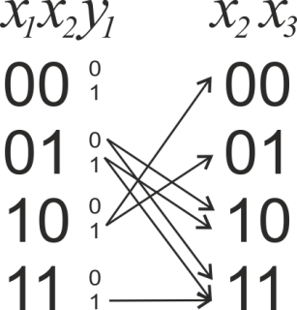
х1 | х2 | х3 | y1
0 | 1 | 0 | 0
 |  |  | 1
 |  | 1 | 0
 |  |  | 1
1 | 0 | 0 | 1
 |  | 1 | 1
 | 1 | 1 | 1

Slide 5
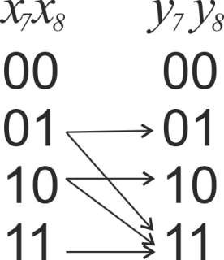
x7 | x8 | y7 | y8
0 | 1 | 0 | 1
 |  | 1 | 1
1 | 0 | 1 | 0
 |  |  | 1
 | 1 | 1 | 1

Slide 6
 | Уравнения 1-6 |  |  |  |  |  |  | Уравнение 7
Пара | x₁,x₂ | x₂,x₃ | x₃,x₄ | x₄,x₅ | x₅,x₆ | x₆,x₇ | x₇,x₈ | y₇,y₈
00 | 1 | 1 | 2 | 2 | 4 | 4 | 8 | 0
01 | 1 | 1 | 2 | 2 | 4 | 4 | 8 | 8
10 | 1 | 2 | 2 | 4 | 4 | 8 | 8 | 8
11 | 1 | 3 | 5 | 9 | 13 | 21 | 29 | 45
61

Slide 7
(x₁ ∧ y₁) ≡ (¬x₂ ∨ ¬y₂)
(x₂ ∧ y₂) ≡ (¬x₃ ∨ ¬y₃)
...
(x₅ ∧ y₅) ≡ (¬x₆ ∨ ¬y₆)
(z₁ ∧ z₂) ≡ (¬z₃ ∨ ¬z₄)
(z₃ ∧ z₄) ≡ (¬z₅ ∨ ¬z₆)
...
(z₉ ∧ z₁₀) ≡ (¬z₁₁ ∨ ¬z₁₂)

Slide 8
x₁ | x₂ | x₃ | x₄
0 | 0 | 0 | 0
 |  |  | 1
 |  | 1 | 0
 |  |  | 1
 | 1 | 0 | 0
 |  |  | 1
 |  | 1 | 0
 |  |  | 1
1 | 0 | 0 | 0
 |  |  | 1
 |  | 1 | 0
 |  |  | 1
 | 1 | 0 | 0
 |  |  | 1
 |  | 1 | 0
 |  |  | 1
(z₁ ∧ z₂) ≡ (¬z₃ ∨ ¬z₄)
Z₁Z₂ Z₃Z₄
00
00
01
01
10
10
11
11

Slide 9
Z₁Z₂ Z₃Z₄
00
00
01
01
10
10
11
11
Пара | Количество пар
 | z₁, z₂ | z₃, z₄ | z₅, z₆ | z₇, z₈ | z₉, z₁₀ | z₁₁, z₁₂
00 | 1
01 | 1
10 | 1
11 | 1
1
3
3
9
9
1
3
3
9
9
1
3
3
9
9
3
3
9
9
27
54

Slide 10
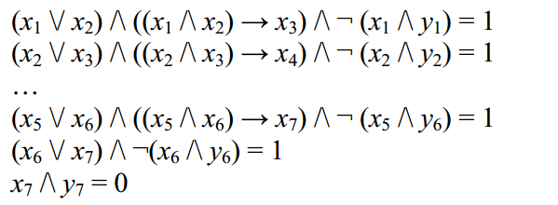
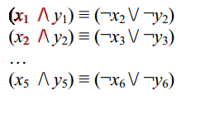
Задания для тренировки
Задание 7.
Задание 8.
X₁ → X₂ ∨ X₃ ∧ ¬X₄ = 1
X₃ → X₄ ∨ X₅ ∧ ¬X₆ = 1
X₅ → X₆ ∨ X₁ ∧ ¬X₂ = 1
Задание 9
Лебедева Елена Валерьевна, alyoninapochta@mail.ru

