Slide 1
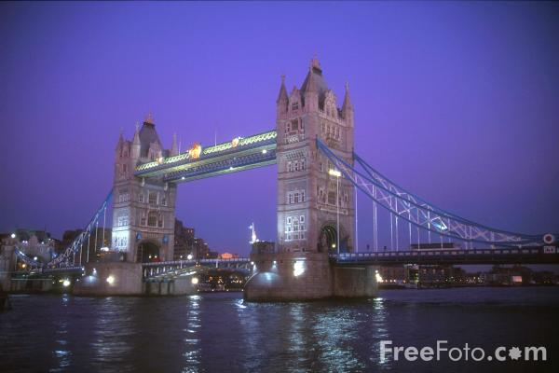
What do we know about the British?

Slide 2
Questions:
How is British life different to a typical Russian lifestyle?
What do you think is typical in Britain?
What do you think the typical British character is?

Slide 3
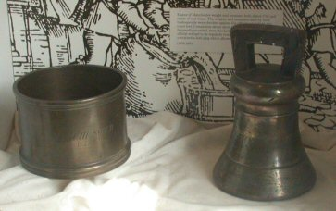
Тhe British are conservative.
They still use their traditional system of weights
and measurements

Slide 4
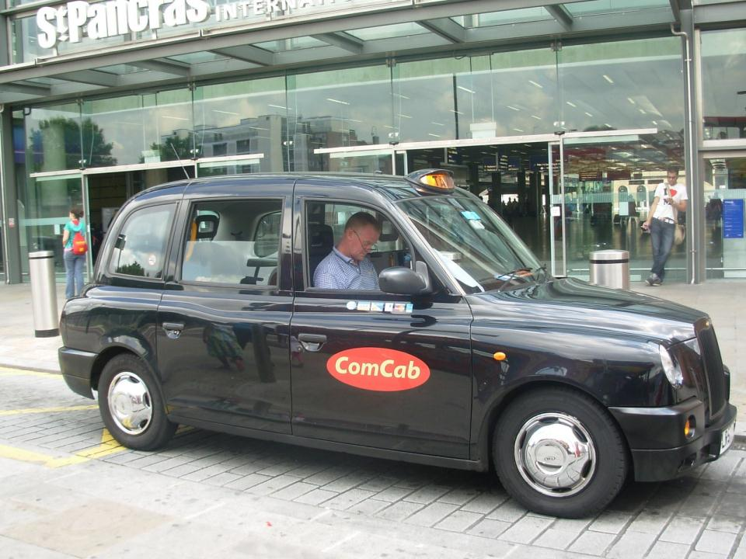
They drive on the left

Slide 5
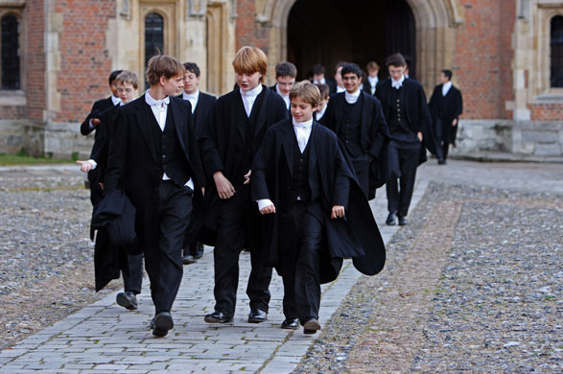
They still wear traditional uniforms at schools

Slide 6
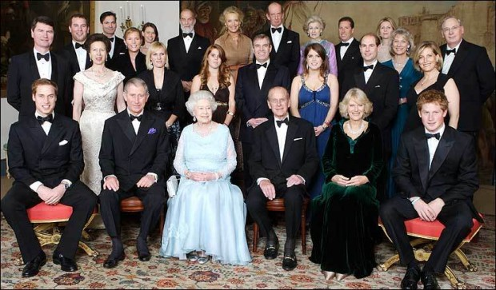
Britain is the oldest democracy in the world and they consider the monarchy an inseparable part of their government.

Slide 7
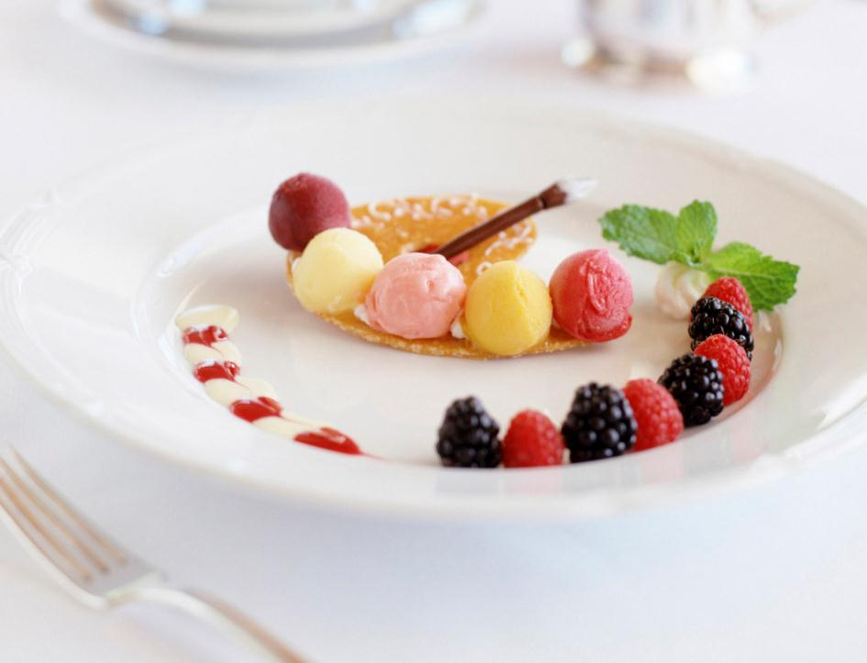
The British are famous for their politeness and good table manners.
The English word “gentleman“ means an honest man with good manners.

Slide 8
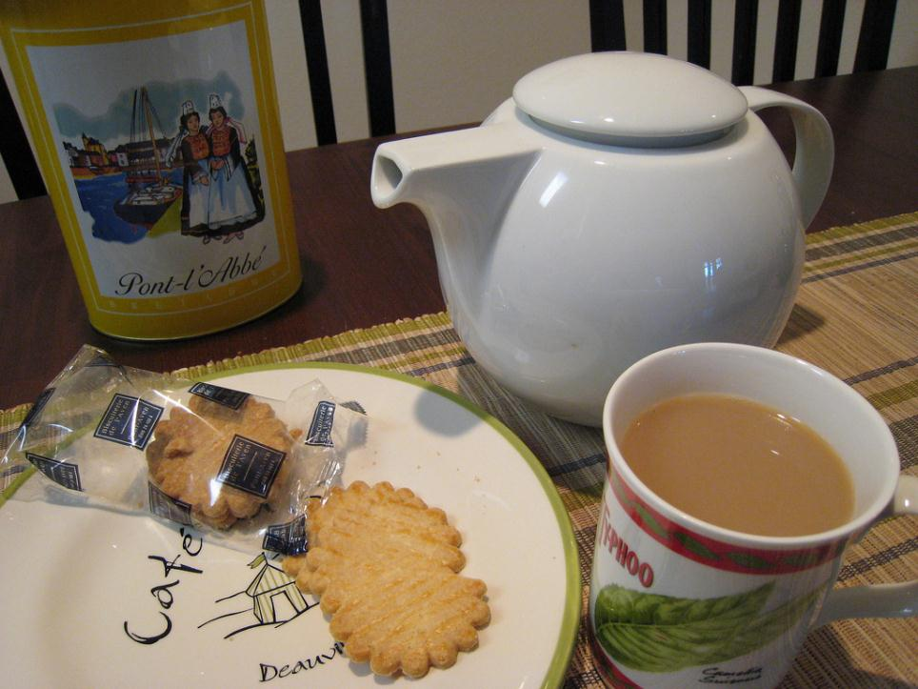
The third stereotype is 5 o’clock tea. And we have discovered that they don’t drink tea exactly at 5 o’clock. But their mania for tea at any time of the day is world famous.

Slide 9
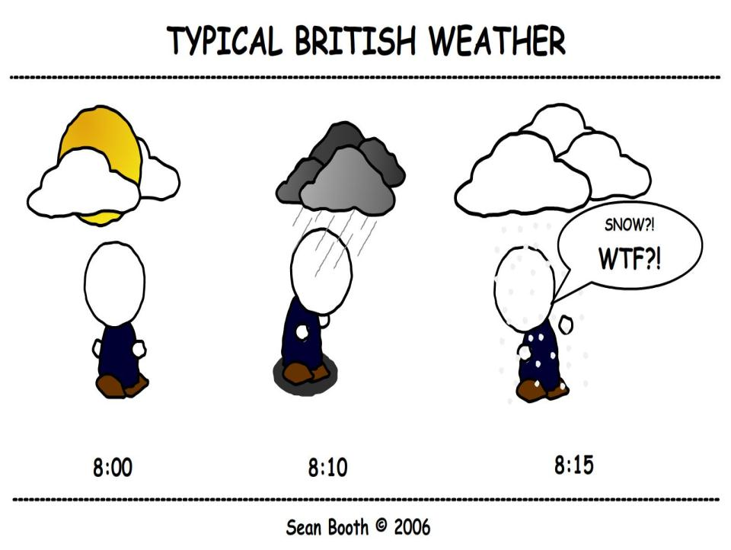
The British talk about the weather a lot.

Slide 10
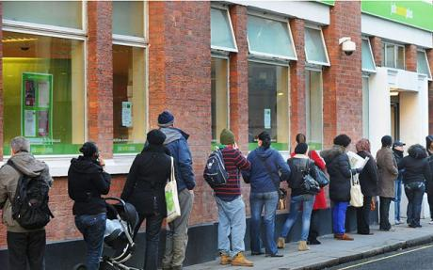
At British banks, shops, cinemas, theatres or bus stops you can always see people in queues. They stand in a line and wait quietly, often for a long time. Queuing is a national passion.

Slide 11
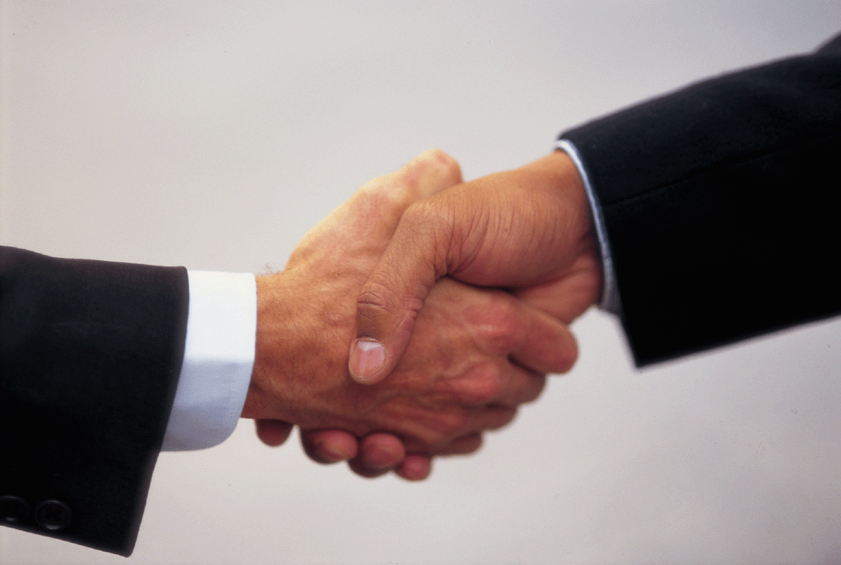
In Britain you don’t shake hands with your friends and family. But you do shake hands when you meet a person for the first time.

Slide 12
To understand the British , one must know from where they come.

